Slide 1
Open government & Open data
A must for transparency, accountability and
access to public information

Slide 2
We must strive for
SUSTAINABLE
DEVELOPMENT

Slide 3
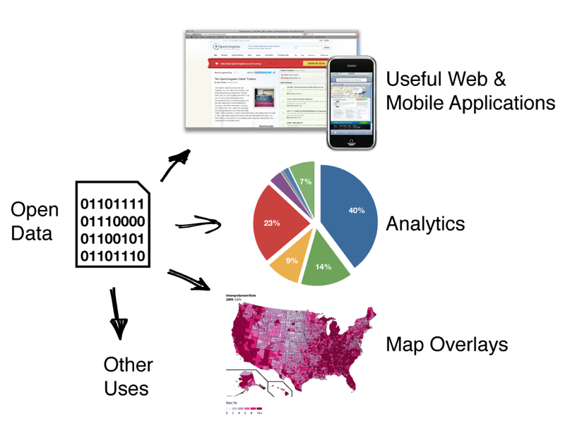
Data Openness and Open Data
What is Open?
Open means anyone can freely access, use, modify, and share for any purpose ..
What is open data?
Availability & Access
Re-Use and Redistribution
Universal participation
Interoperability

Slide 4
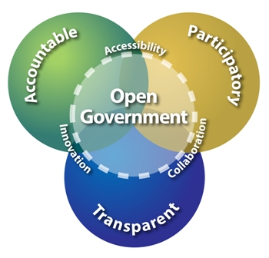
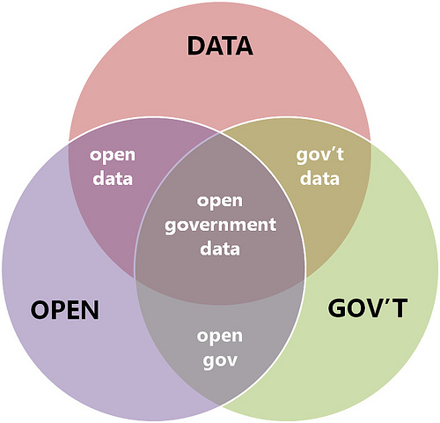
Open Government Data (OGD)
What is open Government data?
OGD is a philosophy- and increasingly a set of policies - that promotes transparency, accountability and value creation by making government data available to all
Anyone to access,
freely use or reuse,
distribute or re-distribute
share without any royalties or restriction
either by technologies or by legal constraints.

Slide 5
Open Government Data & Sustainable Development Goals
GOAL 16. Promote peaceful and inclusive societies for sustainable development, provide access to justice for all and build effective, accountable and inclusive institutions at all levels.
GOAL 17. Strengthen the means of implementation and revitalize the global partnership for sustainable development.

Slide 6
Open Government Data & Sustainable Development Goals and Indicators
16.6 Develop effective, accountable and transparent institutions at all levels. 16.7 Ensure responsive, inclusive, participatory and representative decision-making at all levels. 16.10 Ensure public access to information … 17.18 By 2020, enhance capacity-building support … to increase significantly the availability of high-quality, timely and reliable data. disaggregated by income, gender, age, race, ethnicity, migratory status, disability, geographic location and other characteristics relevant in national contexts.

Slide 7
Benefits of Open Government Data(OGD)
Benefit to government
Increased tax revenues
Creation of jobs
Reduction in data transaction costs
Increased service efficiency
Increased GDP
Benefits for individual users
Easier interaction with the government
Improved data availability to the researchers
Better navigation facilitated by mapping data, databases of points of interest, etc
Benefit to private sector
New business opportunities
Reduced costs for data conversion
Better-skilled workforce
General Benefits
Open data empowering transformation in specific sectors
Open data generating new kinds of Public-Private partnership models
Benefit to NGOs / civil society
Better informed monitoring
New avenues for project action: building tools/applications
Data sharing policy
Maximizing Use
Avoiding duplication
Ownership information
Better decision-making

Slide 8
Data Formats for OGD
Data has to be published in open format. It should be machine readable. Though there are many formats suitable to different category of data. Based on current analysis of data formats prevalent in Government it is proposed that data should be published in any of the following formats: CSV (Comma separated Values) XLS (spread sheet- Excel) ODS (Open Document Formats for Spreadsheet) XML (Extensive Markup Language) RDF (Resources Description Framework) KML (Keyhole Markup Language used for Maps) GML (Geography Markup Language) RSS/ATOM (Fast changing data e.g. hourly/daily)

Slide 9
Identification of Resources (Datasets/Apps) and their organization under Catalogs
Each department of Govt. has to prepare its confidential List (The datasets which are restricted in nature and are in the interest of the country’s security in not opening to the public would fall into the confidential list). All other datasets which do not fall under this confidential list would be in the Open List. These datasets would need to be prioritized into high value datasets and non-high value datasets. All these datasets need to be published on the OGD Platform and high value datasets need to be published as priority base. Government data generated through following processes: Primary Data e.g. Population Census, Education Census, Economic Survey, etc. Processed/Value Added Data e.g. Budget, Planning etc. Data Generated through delivery of Government Services e.g. Free Medicine distribution, Income Tax Collection, Wage distribution etc.

Slide 10
Principles and Criteria of OGD
Each department shall have its own criteria for High value datasets Low value datasets Open Government data is governed by following Principles: Completeness Primary Timeliness Ease of Physical and Electronic Access Machine readability Non-discrimination Use of Commonly Owned Standards Licensing Permanence Usage Costs

Slide 11
OGD Initiatives in Developing Countries
Kenya
In July 2011, Kenya become one of the first African countries and 22nd internationally to launch an Open Data initiative, making over 160 government datasets freely available through a publicly accessible online portal. The portal hosts over four hundred government datasets as well as 2009 census, national and regional expenditure and data on key public services like education, health and agriculture etc

Slide 12
OGD Initiatives in Developing Countries
Moldova
The Moldova open data website-- the first in the region – launched in 2012 with 67 data sets from 5 agencies, with each agency providing a minimum of 3 data sets per month to create a pipeline of data. First country in the World to publish the entire Government expenditure dataset in one consolidated excel file.
Chile
Chile was among the first few countries in Latin America to adopt open data through a portal. Recently public procurement data has been released to support the initiative. A recent study on judiciary data, including budget allocations, performance statistics, court rulings, selection and removal of magistrates, and hiring and personnel details found Chile at the top of its performance compared to other countries in the region.

Slide 13
OGD Ranking of Bangladesh (Global Open Data Index)
3:31 PM
Year | Rank | Total Countries
2013 | 45 | 75
2014 | 63 | 101
2015 | 69 | 118

Slide 14
Background:
A workshop was held on 23 to 25 August, 2015 on the topics of “Open Government Data (OGD) Sensitization, Gap Assessment and Strategic planning”
A Policymakers meeting was held in Bangladesh on Open Government Data (OGD) Last 11, November 2015, presided over by the principal Secretary,
Abul Kalam Azad at the Prime Minister's Office.
The following committee has been formed to implement/run OGD activities.
a)Open data Executive committee headed by Secretary (coordination & reform), Cabinet division.
b)Open data Strategy Review and Formulation committee headed by Secretary, SID.
c)Open data Working group committee headed by Additional Secretary, SID.
d)Open data Implementation committee headed by Project director, a2i.

Slide 15
Open data Current Status:
•OGD Platform is Developed and beta live.
Enhancement of OGD Platform is ongoing for adding new features.
•OGD Domain is registered under SID.
•‘Open Government Data Strategy’ document (English) is approved by the Minister.
•Prepared User ID & Passwords for Stakeholders/ Data Providers at OGD platform for Datasets sharing/uploading.
•Created API at OGD platform to Extract Data From SDG Tracker & National Portal.
•Started Dataset Collection Process ( One to one meeting with Ministries / Departments) for providing potential Datasets from Affiliated Agencies.
•Created 12 priority category at OGD Platform
•Redatam implementation in BBS domain
•GIS Application in BBS domain
•BD info in BBS domain
•Small area Atlas in BBS domain

Slide 16
DATA.GOV.BD
Open Government Data (OGD) Strategy
Domain : data.gov.bd
Registration time: January 2016
Name of Organization: Statistics & Informatics Division (SID)

Slide 17
Metadata Elements for Catalogs and their Description of OGD
Metadata Title (Required): A unique name for the metadata (group of resources) viz. Current Population Survey <Year>, Consumer Price Index <Year>, Variety-wise Daily Market Prices Data, State-wise Construction of Deep Tube wells over the years, etc. Description (Required): Provide a detailed description of the catalog e.g., an abstract determining the nature and purpose of the catalog. Keywords (Required): It is a list of terms, separated by commas, describing and indicating at the content of the catalog. Example: rainfall, weather, monthly statistics. Group Name: This is an optional field to provide a Group Name to multiple catalogs in order to show that they may be presented as a group or a set. Sector & Sub-Sector (Required): Choose the sectors(s)/sub-sector(s) those most closely apply(ies) to your catalog. Asset Jurisdiction (Required): This is a required field to identify the exact location or area to which the catalog and resources (dataset/apps) caters to viz. entire country, Division, district, city, etc.

Slide 18
Metadata Elements for Resources and their Description of OGD
Resources (Datasets/Apps) Category (Required): Choose from the drop-down options. Is it a Dataset or an Application. Title (Required): A unique name of the resource viz. Consumer Price Index for <Month/Year> etc. Access Method (Required): This could be “Upload a Dataset” or “Single Click Link to Dataset”. Reference URLs: This may include description to the study design, instrumentation, implementation, limitations, and appropriate use of the dataset or tool. In the case of multiple documents or URLs, please delimit with commas or enter in separate lines.

Slide 19
Metadata Elements for Resources and their Description of OGD
If Resource Category is Dataset Frequency (Required): It mentions the time interval over which the dataset is published on the OGD Platform on a regular interval (one-time, annual, hourly, etc.). Granularity of Data: It mentions the time interval over which the data inside the dataset is collected/ updated on a regular basis (one-time, annual, hourly, etc.). Access Type: It mentions the type of access viz. Open, Priced, Registered Access or Restricted Access (G2G). If Resource Category is App App Type (Required): It mentions the type of App being contributed viz. Web App, Web Service, Mobile App, Web Map Service, RSS, APIs etc. Datasets Used: Datasets used for making this app. Language: Language used for app. Date Released: It mentions the release date of the Dataset/App. Note: It mentions the anymore information the contributor/ controller wishes to provide to the data consumer or about the resource.

Slide 20
Role of Users at OGD Portal
Data Provider a) Entry Data. b) Show respective Dashboard & Report c) Send data for Approval Data Approver a) Approve/ Disapprove data b) Show respective Dashboard & Report 3. Data publisher a) Publish data b) Show respective Dashboard & Report

Slide 21
Data Identification Process by the Ministries
Prepare Datasets according to guideline a) Analyze the data b) Analyze the rules and Terms. I) prepare its confidential List of datasets. II) prepare its Open List of Datasets. C)Identifying The Data Sets for Upload in OGD Portal Prepare data catalogs(Metadata) for each datasets according to guideline. 3. Upload data to OGD portal.

Slide 22
Open Government:
Open Government is a cultural change towards new relationships between governments and citizens.
Open Government policies embrace the use of modern ICT and data as resources and tools to create more meaningful interactions between citizens and governments.
*Data in 3Ps*
Data of the People
data by the People
data for the People
**data for everybody**
** DATA FOR PEOPLE & PLANET **
Our Vision Statement:
***Data for all***

Slide 24
Thank You…….

